Slide 1
6. Demostrate how to use the security configuration wizard. Provide some steps and screenshots (or video).
Homework

Slide 2
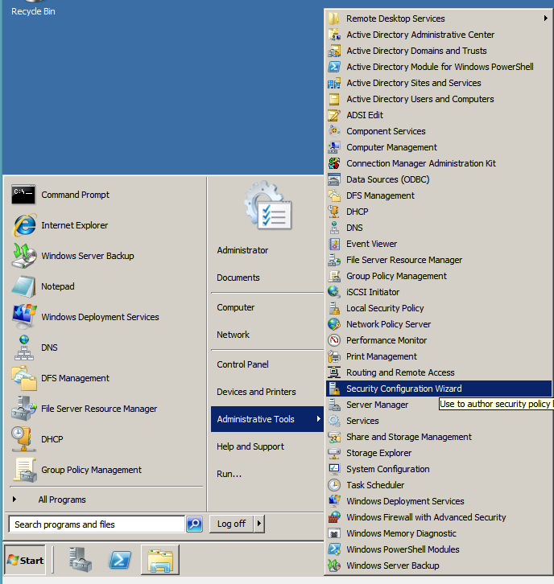
Security Configuration Wizard
Notes:
We start the wizard from the Administrative Tools menu.

Slide 3
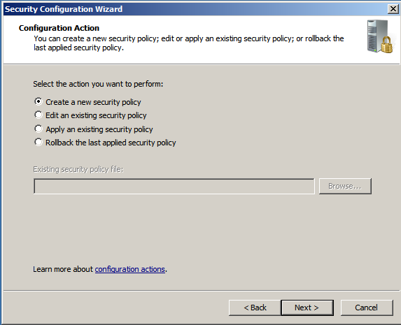
Security Configuration Wizard
Notes:
We choose to create a new security policy…

Slide 4
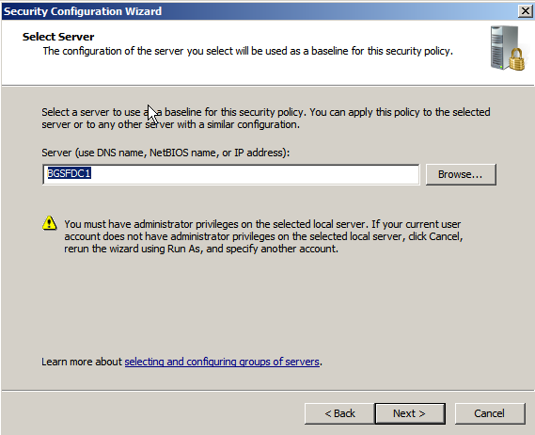
Security Configuration Wizard
Notes:
We choose the server to be used as a baseline.

Slide 5
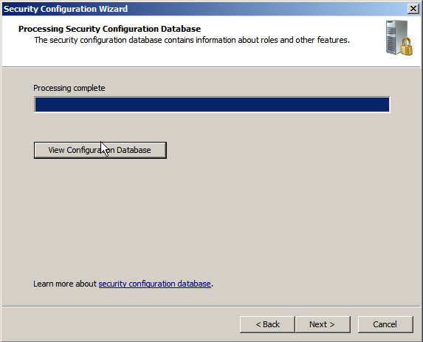
Security Configuration Wizard
Notes:
Once the processing of the Security Configuration Database is finished we can view the configuration database…

Slide 6
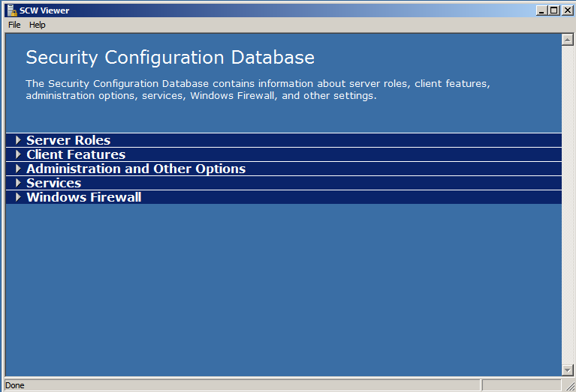
Security Configuration Wizard
Notes:
The Configuration Database…

Slide 7
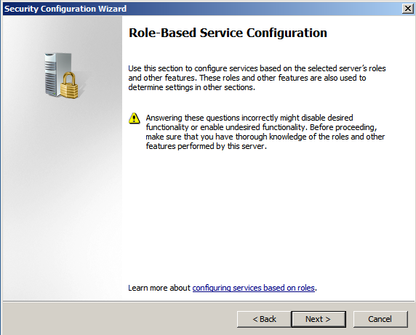
Security Configuration Wizard
Notes:
Now we are ready to start answering the questions…

Slide 8
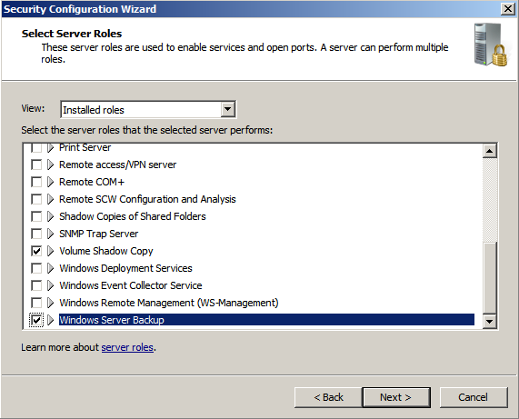
Security Configuration Wizard
Notes:
I choose the Windows Server Backup role (Volume Shadow copy is automatically selected)

Slide 9
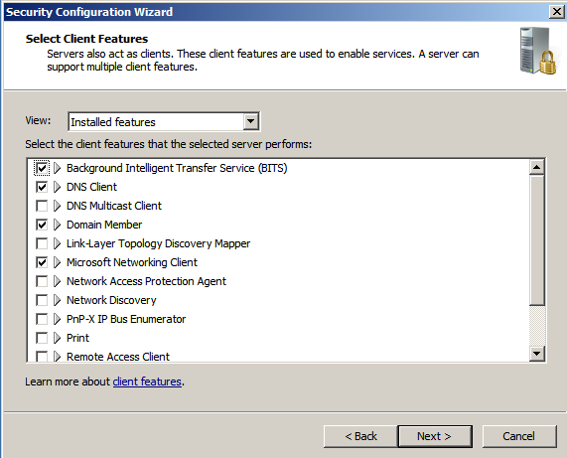
Security Configuration Wizard
Notes:
Here we can choose also the Client Features…

Slide 10
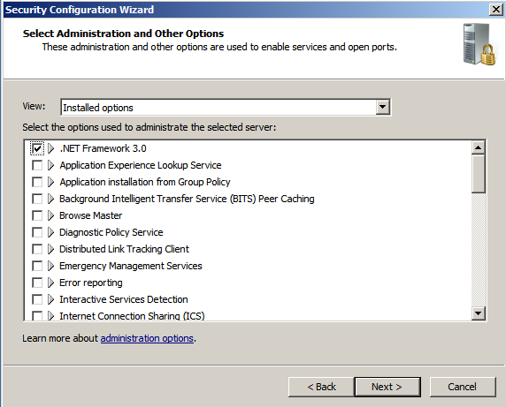
Security Configuration Wizard
Notes:
Other options…

Slide 11
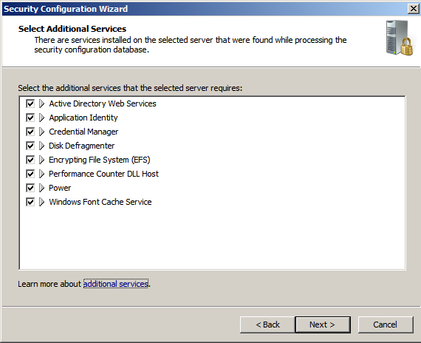
Security Configuration Wizard
Notes:
Here we can select the Additional Services we use…

Slide 12
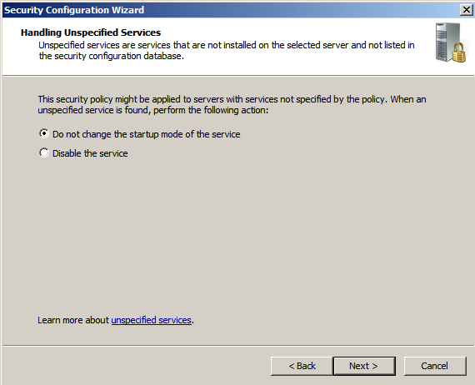
Security Configuration Wizard
Notes:
Here we choose what to do with the unspecified services.

Slide 13
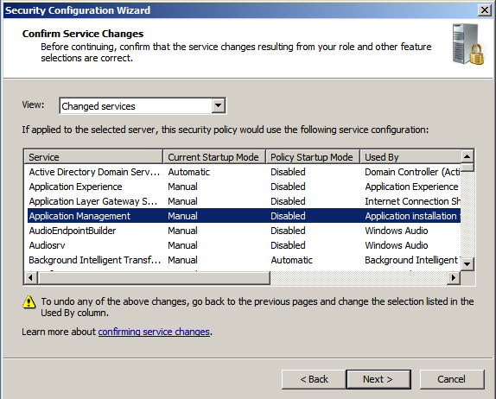
Security Configuration Wizard
Notes:
Here we can check the changes that are going to be applied. If everything is ok then we confirm by clicking Next…

Slide 14
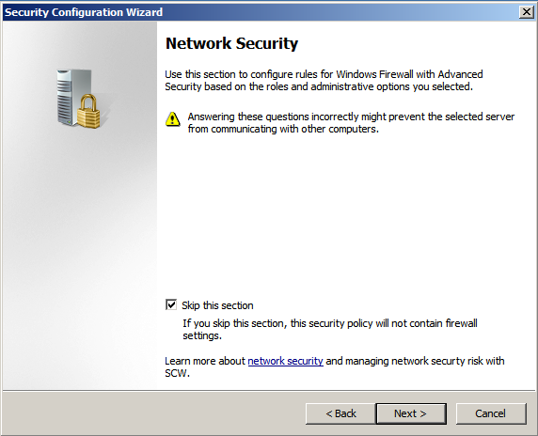
Security Configuration Wizard
Notes:
We can also configure Network Security Rules. I choose to skip that for now.

Slide 15
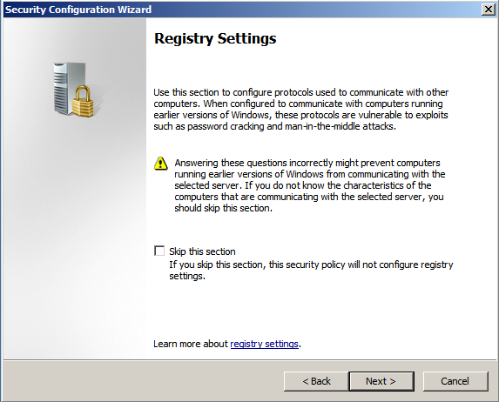
Security Configuration Wizard
Notes:
The same with Registry settings…

Slide 16
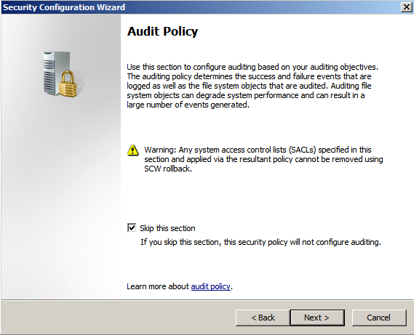
Security Configuration Wizard
Notes:
…and Audit Policy…

Slide 17
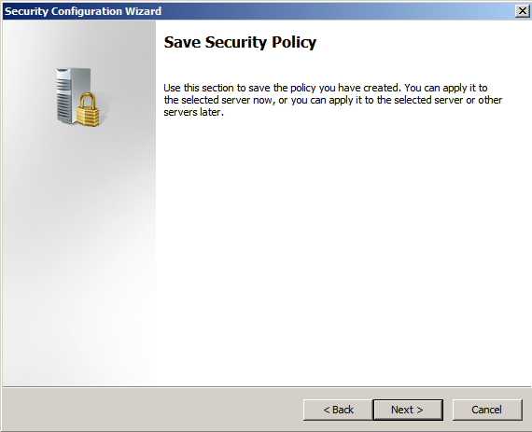
Security Configuration Wizard
Notes:
Now we will choose how and where to save the created Security Policy.

Slide 18
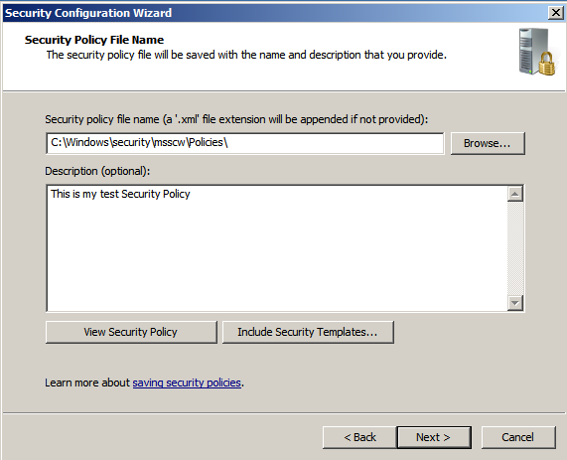
Security Configuration Wizard
Notes:
…

Slide 19
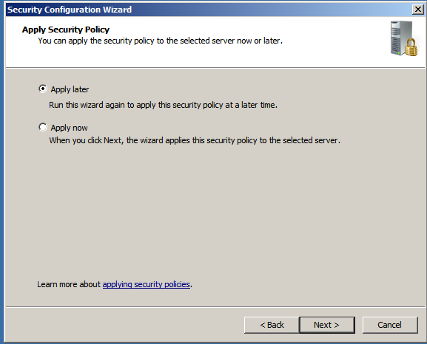
Security Configuration Wizard
Notes:
We choose whether to apply the policy now or latter…

Slide 20
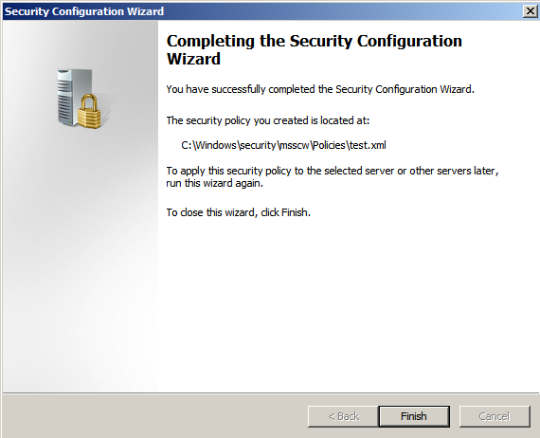
Security Configuration Wizard
Notes:
This is it.

